Slide 1
Exploring merged means test options
Andrew Podger
David Knox
(With assistance from David Stanton)
CEPAR Conference December 2019

Slide 2
Key assumption
Australia will not ever agree to and sustain a means-test-free age pension
  Notwithstanding the advantages of simplicity and coordination with superannuation and the tax system
    Even the 1984 Gruen Report that led to reintroduction of an assets test argued for the eventual move to a universal pension
  Partly because of the cost, but also because of over a century of history and the path dependency this has clearly imposed
But successive inquiries have advocated a move to a simpler, income-based test with tapers that allow rewards for work and saving
  Henderson 1976, Income Security Review 1977, Henry 2010
  The means test was progressively liberalised between 1908 and 1983

Slide 3
Problems of current separate income and assets tests
Inconsistencies between the tests
  Illustrated by differences in equivalent cut-out points (for a couple, $81,172 under income test, around $50,000 actuarial value (depending on price assumption) of assets test cut-out)
Distortions of assets test taper
  Incentives for those within taper range to shift assets away from superannuation-funded income streams, limit additional super savings
  Moral issue where people compelled to contribute when not in their financial interests
Complexity
  ‘Deeming’ arrangements, special arrangements for annuities etc
More broadly, detracts from focus on retirement income streams

Slide 4
Basis of original 1960s merged means test (Kewley 1973)
Assessable assets converted into equivalent (potential) income stream over retirement years
  Based on CPI-indexed annuity for man aged 65
  Single factor (10%), not adjusted for age or for prevailing interest rates
This equivalent income added to any other income (of individual or couple), the total subject to the tapered means test
  With ‘free areas’ and no separate threshold for assessable assets)
  50% taper above free areas
  Annuities treated directly as income, including return-of-capital component

Slide 5
Applying original model today
Conversion factor of assessable assets into equivalent income
  Current market price of annuity for man aged 67 (or couple with survivor benefits) is under 5%
  Case for applying different standard
    No profit margin
    No adjustment for possible selection bias
    No residual benefit
    Presumption of real interest rates higher than right now (say, 2-3%)
  Suggests factor of around 6%, with no adjustment for prevailing interest rates (6.3% without reversion; 5.5% with reversion)
Annuities actually purchased to be treated as income
No separate assets test threshold, just income test free areas

Slide 6
Impact of original merged means test model today
Assets threshold (if no other income)
  $133,467 for couple (when income test threshold is reached)
  Compared to $394,500 for home-owning couple at present
Effective taper above threshold
  3% (6% conversion factor halved by 50% income test taper)
  Compared to 7.8% currently (3.9% previously)
Cut-out points
  $.... when income test cut-out reached by couple
  Compared to $863,500 for home-owning couple at present

Slide 7
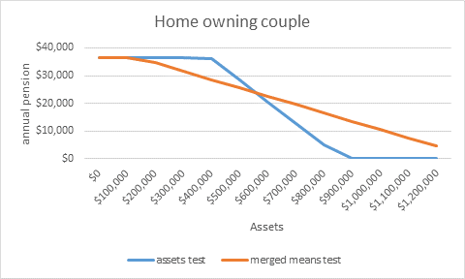
Impact of original merged means test model today

Slide 8
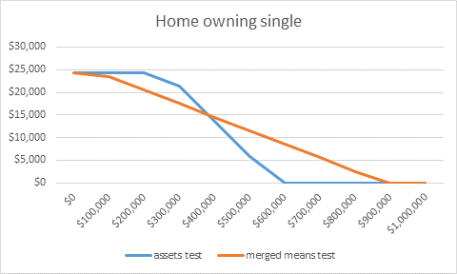
Impact of original merged means test model today

Slide 9
Possible modifications to this original model
Introduce assessable assets thresholds
  Limit losers amongst those with modest assets
  Keep higher threshold for renters than home-owners (difference perhaps linked to value of modest home – say, at first or second decile)
Adjust income test thresholds
  Alternative way to limit losers
Apply slightly higher conversion factor (say, 7%)
  Rewarding those who actually purchase annuities, limiting gains for rich
Phase in inclusion of home value
  Limit gains to high asset holders, more equal treatment of different assets
  Perhaps with high threshold (say, at 8th or 9th decile) and phased in
  May require option to purchase pension by borrowing from estate

Slide 10
Impact of modified version, assets thresholds $100,000 (home-owner), $350,000 (non-home-owner)
(home-owning couple)

Slide 11

Impact of modified version, assets thresholds $100,000 (home-owner), $350,000 (non-home-owner)

Slide 12
Impact of modified version, assets thresholds $100,000 (home-owner), $350,000 (non-home-owner)
(Renting couple and renting single graphs to come)

Slide 13
Other means test options
Actuaries Institute Green Paper presents several other options
Option 1 is to ‘simplify the age pension’
  At best these measures might promote everyone receiving at least the maximum rate of pension as an income stream
  But they do not address the wider problems of retirement incomes and super-age pension relations
Option 2 focuses mainly on having a merged means test
  With no details, but a useful suggestion to explore the link between the age pension means test and the means test for aged care
  This relates in large part to the appropriate treatment of the home, perhaps justifying generous treatment for pension purposes and firmer treatment for residential aged care

Slide 14
Option 3 is ‘A universal minimum Age Pension’
  Equal to 10% of the average wage, supplemented by a more strictly means-tested supplement to achieve a safety net equal to the current maximum rate
  While ensuring far fewer people are subject to the high emtrs of the means test (though the emtrs would be higher than now), the measure would be expensive
    The 30% now expected in future to be on maximum rates would be unaffected
    The 30% now expected to be on part rates would mostly see these reduce somewhat (ie the main losers would be similar to those who would lose under the merged means test options)
    But the 40% now expected to have no pension would gain the new universal payment (ie there would be many more winners amongst high asset owners than under the merged means test options).
  Would such an option be sustained, or be subject to continuing tinkering?

Slide 15
Re-establishing focus on retirement income streams
CIPRS agenda important but insufficient
Need for regular reporting, at least from age 50, of likely income streams from current saving to preservation or age pension age
  Related to current real earnings, based on some standard ‘price’ of indexed annuity
  Also, capacity to explore likely pension eligibility
Perhaps expert views of role of annuities still shifting
  From widespread support, at least in theory, and attractions of BP schemes
  To suggestions of superiority of allocated pensions plus deferred annuities
  Now to uncertainty about the practicality of deferred annuities and unease about the risks of excessive reliance on allocated pensions
Merged means test could be important part of this wider agenda

